Slide 1
Chapter 6
Are Financial
Markets Efficient?

Slide 2
Financial System Overview (2)
Financial Markets
Financial Institutions
Bond Market (3,5,12)
Stock Market (13,6)
Money Market (11)
Mortgage Market (14)
Why Exists (7)
Banking Industry (19)
Mutual Fund Industry(20)
Hedging with Financial Derivatives (24)

Slide 3
Chapter Outline
The Efficient Market Hypothesis (EMH)
Evidence on the Efficient Market Hypothesis
Favorable
Unfavorable
Implications for investing

Slide 4
Determining the required rate of return
CAPM model:
R_{j} = R_{f} + B_{j} (R_{m} – R_{f} )
R_{f} is risk-free rate (yield on newly issued Treasury 3-month T-bill rate).
B_{j} is called “the beta” and is equal to COV(R_{j}, R_{m}) / VAR(R_{m})
R_{m} – R_{f} is the market premium (Usually, we use the average return on S&P 500 as the market return R_{m}. )
For Example:
“Risk-free” rate of return = 4% per year
Expected market return = 15% per year
In order to know the required return for Microsoft, we only need to know B_{j.} How to get the B_{j.}?

Slide 5
Calculation of Beta

Slide 6
Application of CAPM
“Risk-free” rate of return = 4% per year
Expected market return = 15% per year
Microsoft = 1.4436
Required return on Microsoft can be calculated as:

Slide 7
Assumptions
Securities markets are very competitive and efficient (that is, relevant information about the companies is quickly and universally distributed and absorbed). All investors have all information regarding all assets, and the investments made are because they pay the highest returns with the least possible risk.
These markets are dominated by rational, risk-averse investors, who seek to maximize satisfaction from returns on their investments.
EF3333 Chapter 6

Slide 8
Arbitrage Pricing Model
The APT suggests that a stock’s price can be influenced by a set of factors in addition to the market
Where E(R) = expected return of asset
B₀ = a constant
F₁, F₂ , … … , F_{m} = values of factors 1 to m
B_{i} = sensitivity of the asset return to factor i
Compare with CAPM Model
It allows for any factor you want to consider (instead of market factor only)
It is not very well defined as the CAPM

Slide 9
Three-Factors, Four-Factors Models
Fama-French three factors model
R_{m} is market return, R_{f} is the risk-free return
SMB is small minus big
HML is high B/M minus low B/M
Slope for (R_{m}-R_{f)} is positive
Slope for SMB: for small firm, it is positive, for big firm, it is negative
Weak firms with persistently low earnings tend to have high B/M and positive slopes on HML; strong firms with persistently high earnings have low B/M and negative slopes on HML
market risk
size risk
value risk

Slide 10
Efficient Capital Markets
Stock prices are in equilibrium or are “fairly” priced
If this is true, then you should not be able to earn “abnormal” or “excess” returns
Efficient markets DO NOT imply that investors cannot earn a positive return in the stock market

Slide 11
Price reaction to new information
Price ($)
Overreaction and correction
220
Efficient market reaction: the price instantaneously adjusts to and fully reflects new information; there is no tendency for subsequent increases and decreases.
Delayed reaction: The price partially adjusts to the new information; eight days elapse before the price completely reflects the new information.
Overreaction and correction: The price over adjusts to the new information; it overshoots the new price and subsequently corrects.
180
140
Delayed reaction
100
Efficient market reaction
-8
-6
-4
-2
0
+2
+4
+6
+8
Days relative to announcement day (Day 0)

Slide 12
What Makes Markets Efficient?
There are many investors out there doing research
As new information comes to market, this information is analyzed and trades are made based on this information
Therefore, prices should reflect all available public information
If investors stop researching stocks, then the market will not be efficient
Have the financial market become more informative over past 50 years? No!

Slide 13
Common Misconceptions about EMH
Efficient markets do not mean that you can’t make money
They do mean that, on average, you will earn a return that is appropriate for the risk undertaken and there is not a bias in prices that can be exploited to earn excess returns
Market efficiency will not protect you from wrong choices if you do not diversify – you still don’t want to put all your eggs in one basket

Slide 14
Weak Form Efficiency
Prices reflect all past market information such as price and volume
If the market is weak form efficient, then investors cannot earn abnormal returns by trading on market information
Implies that technical analysis will not lead to abnormal returns
Empirical evidence indicates that markets are generally weak form efficient

Slide 15
Semi-strong Form Efficiency
Prices reflect all publicly available information including trading information, annual reports, press releases, etc.
If the market is semi-strong form efficient, then investors cannot earn abnormal returns by trading on public information
Implies that fundamental analysis will not lead to abnormal returns

Slide 16
Strong Form Efficiency
Prices reflect all information, including public and private
If the market is strong form efficient, then investors could not earn abnormal returns regardless of the information they possessed
Empirical evidence indicates that markets are NOT strong form efficient and that insiders could earn abnormal returns

Slide 17
STRONG
Public & Private Information
WEAK
Security Market Information
SEMISTRONG
Public Information

Slide 18
Evidence on Efficient Market Hypothesis: Favorable
Investment analysts and mutual funds don't beat the market
Stock prices reflect publicly available info
Technical analysis does not outperform market

Slide 19

Evidence in Favor of Market Efficiency
Performance of Investment Analysts and Mutual Funds should not be able to consistently beat the market
The “Investment Dartboard” often beats investment managers.
Mutual funds do not outperform the market on average.
Investment strategies using inside information is the only “proven method” to beat the market. It is illegal to trade on such information.

Slide 20
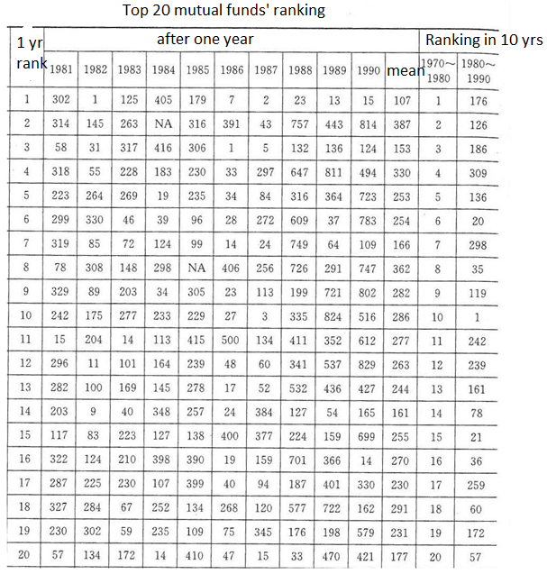


Slide 21
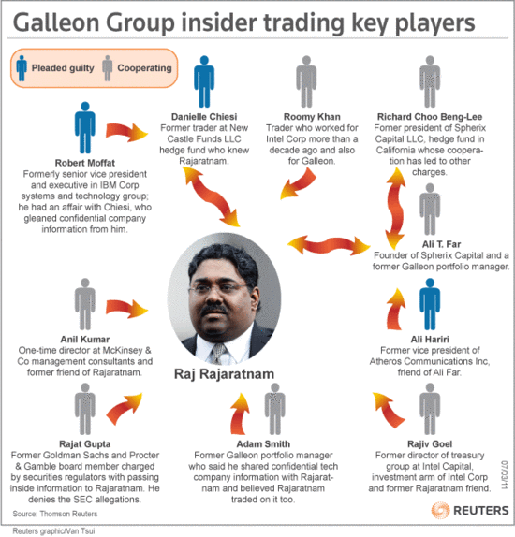
Mini-Case: Raj Rajaratnam
In the mid-2000s, Mr. Rajaratnam made millions of dollars for himself and his investors by investing in firms on which he allegedly received inside information.
His strategy shows that you can profit from information that the market does not have. But that strategy landed him in jail for insider trading.

Slide 22
Evidence in Favor of Market Efficiency
Do Stock Prices Reflect Publicly Available Information as the EMH predicts they will?
If information is already publicly available, a positive announcement about a company will not, on average, raise the price of its stock because this information is already reflected in the stock price.
Early empirical evidence confirms: favorable earnings announcements or announcements of stock splits (a division of a share of stock into multiple shares, which is usually followed by higher earnings) do not, on average, cause stock prices to rise.

Slide 23
Evidence in Favor of Market Efficiency
Random-Walk Behavior of Stock Prices that is, future changes in stock prices should, for all practical purposes, be unpredictable
If stock is predicted to rise, people will buy to equilibrium level; if stock is predicted to fall, people will sell to equilibrium level (both in concert with EMH)
Thus, if stock prices were predictable, thereby causing the above behavior, price changes would be near zero, which has not been the case historically

Slide 24

Evidence in Favor of Market Efficiency
Technical Analysis is the study past stock price data, searching for patterns such as trends and regular cycles, suggesting rules for when to buy and sell stocks
The EMH suggests that technical analysis is a waste of time
Therefore, technical analysis, which relies on past stock price data to produce its forecasts, cannot successfully predict changes in stock prices

Slide 25
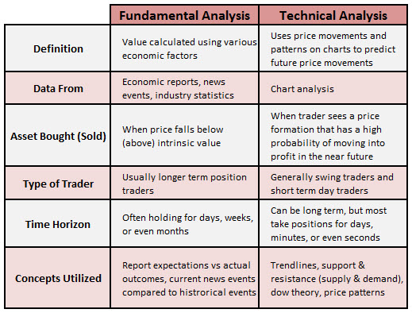
http://www.finila.com/shop/fundamental-and-technical-analysis/

Slide 26
Evidence on Efficient Market Hypothesis: Unfavorable
Small-firm effect: small firms have abnormally high returns
January effect: high returns in January
Market overreaction
Excessive volatility
Mean reversion
New information is not always immediately incorporated into stock prices

Slide 27
Small-Firm Effect
The Small-Firm Effect is an anomaly. Many empirical studies have shown that small firms have earned abnormally high returns over long periods of time, even when the greater risk for these firms has been considered.
Various theories have been developed to explain the small-firm effect, suggesting that it may be due to
low liquidity of small-firm stocks,
large information costs in evaluating small firms, or
an inappropriate measurement of risk for small-firm stocks

Slide 28
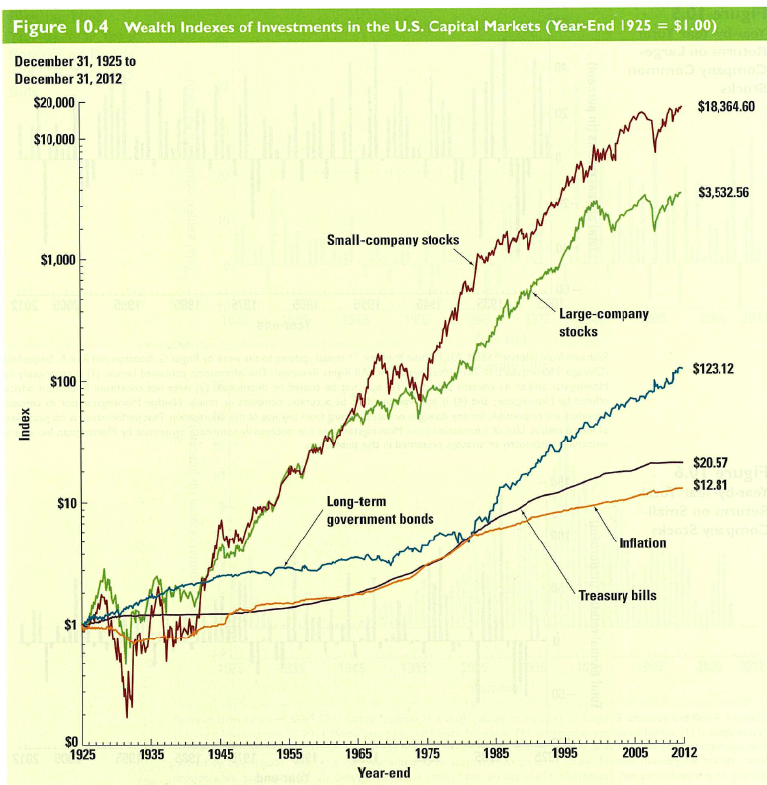

Slide 29
January Effect
The January Effect is the tendency of stock prices to experience an abnormal positive return in the month of January that is predictable and, hence, inconsistent with random-walk behavior
Investors have an incentive to sell stocks before the end of the year in December because they can then take capital losses on their tax return and reduce their tax liability.
Then when the new year starts in January, they can repurchase the stocks, driving up their prices and producing abnormally high returns.

Slide 30
January Effect
Although this explanation seems sensible, it does not explain why institutional investors such as private pension funds, which are not subject to income taxes, do not take advantage of the abnormal returns in January and buy stocks in December, thus bidding up their price and eliminating the abnormal returns.

Slide 31
Market Overreaction
Market Overreaction: recent research suggests that stock prices may overreact to news announcements and that the pricing errors are corrected only slowly
When corporations announce a major change in earnings, say, a large decline, the stock price may overshoot, and after an initial large decline, it may rise back to more normal levels over a period of several weeks.
This violates the EMH because an investor could earn abnormally high returns, on average, by buying a stock immediately after a poor earnings announcement and then selling it after a couple of weeks when it has risen back to normal levels.

Slide 32

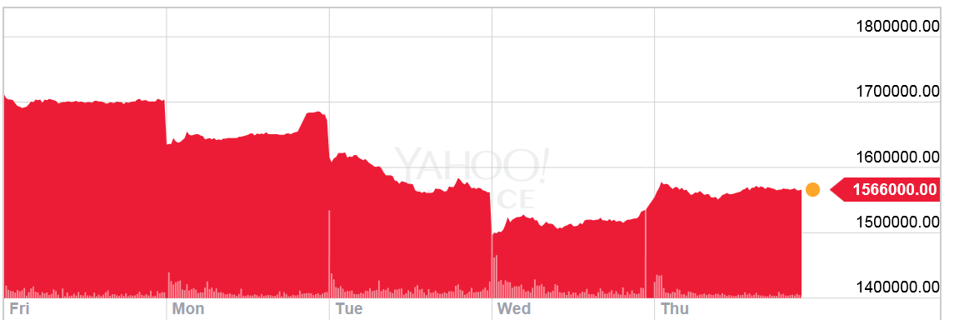
Note 7

Slide 33
Excessive Volatility
Excessive Volatility: the stock market appears to display excessive volatility; that is, fluctuations in stock prices may be much greater than is warranted by fluctuations in their fundamental value.
Researchers have found that fluctuations in the S&P 500 stock index could not be justified by the subsequent fluctuations in the dividends of the stocks making up this index.
Other research finds that there are smaller fluctuations in stock prices when stock markets are closed, which has produced a consensus that stock market prices appear to be driven by factors other than fundamentals.

Slide 34
Mean Reversion
Mean Reversion: Some researchers have found that stocks with low returns today tend to have high returns in the future, and vice versa.
Hence stocks that have done poorly in the past are more likely to do well in the future because mean reversion indicates that there will be a predictable positive change in the future price, suggesting that stock prices are not a random walk.
Newer data is less conclusive; nevertheless, mean reversion remains controversial.

Slide 35
New Information
New Information Is Not Always Immediately Incorporated into Stock Prices
Although generally true, recent evidence suggests that, inconsistent with the efficient market hypothesis, stock prices do not instantaneously adjust to profit announcements.
Instead, on average stock prices continue to rise for some time after the announcement of unexpectedly high profits, and they continue to fall after surprisingly low profit announcements.
Post-Earnings-Announcement-Drift (PEAD)

Slide 36
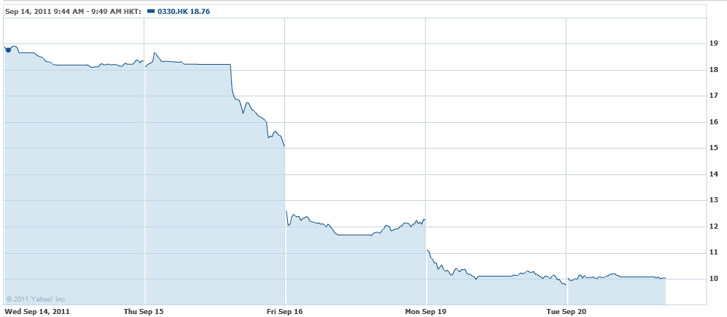
Esprit(330.HK) released 2011semi-annual report

Slide 37
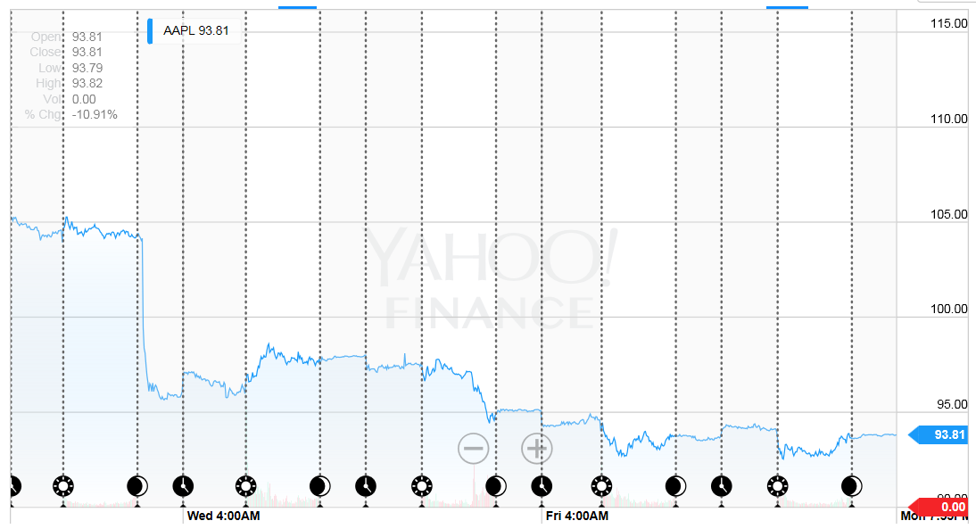

Slide 38
Implications for Investing
How valuable are published reports by investment advisors?
Do stock prices always rise when there is good news?
Efficient Markets prescription for investor
Should you be skeptical of hot tips?

Slide 39
Implications for Investing
How valuable are published reports by investment advisors?
The efficient market hypothesis tells us that when purchasing a security, we cannot expect to earn an abnormally high return.
Information in newspapers and in the published reports of investment advisers is readily available to many market participants and is already reflected in market prices.
Recommendations from investment advisers cannot help us outperform the general market.

Slide 40
Implications for Investing
Should you be skeptical of hot tips?
YES. The EMH indicates that you should be skeptical of hot tips since, if the stock market is efficient, it has already priced the hot tip stock so that its expected return will equal the equilibrium return.
Thus, the hot tip is not particularly valuable and will not enable you to earn an abnormally high return.
As soon as the information hits the street, the unexploited profit opportunity it creates will be quickly eliminated.
The stock’s price will already reflect the information, and you should expect to realize only the equilibrium return.

Slide 41
Implications for Investing
Do stock prices always rise when there is good news?
NO. In an efficient market, stock prices will respond to announcements only when the information being announced is new and unexpected.
So, if good news was expected (or as good as expected), there will be no stock price response.
And, if good news was unexpected (or not as good as expected), there will be a stock price response.

Slide 42
Implications for Investing
Efficient Markets prescription for investor
Investors should not try to outguess the market by constantly buying and selling securities. This process does nothing but incur commissions costs on each trade.
Instead, the investor should pursue a “buy and hold” strategy—purchase stocks and hold them for long periods of time.
This will lead to the same returns, on average, but the investor’s net profits will be higher because fewer brokerage commissions will have to be paid.

Slide 43
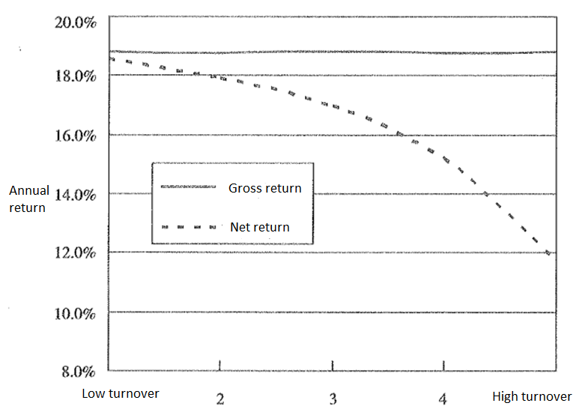

Slide 44
Implications for Investing
Efficient Markets prescription for investor
It is frequently a sensible strategy for a small investor, whose costs of managing a portfolio may be high relative to its size, to buy into a mutual fund rather than individual stocks.
Because the EMH indicates that no mutual fund can consistently outperform the market, an investor should not buy into one that has high management fees or that pays sales commissions to brokers but rather should purchase a no-load (commission-free) mutual fund that has low management fees.

Slide 45
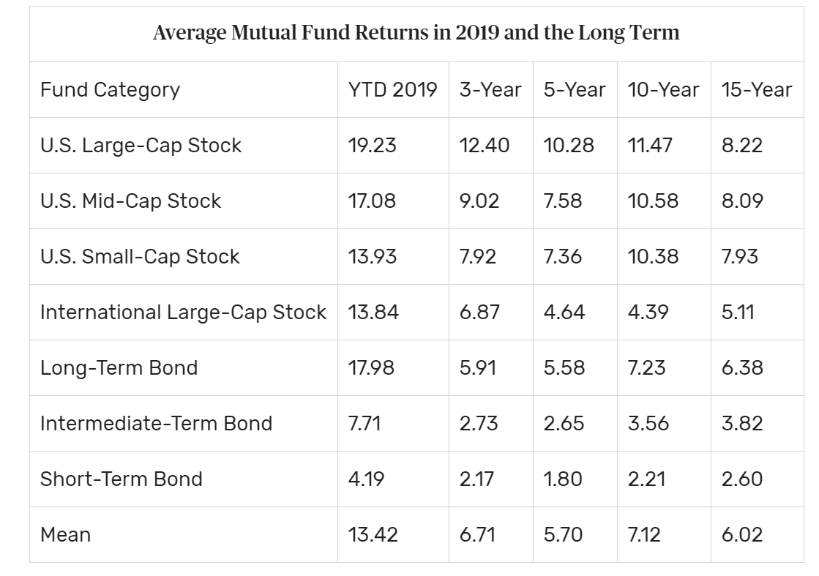
Implications for Investing
The S&P 500 Index as a benchmark
Average annual return of nearly 13% over the past 10 years and about 9% over the past 15 years.

Slide 46
Why the EMH Does Not Imply That Financial Markets Are Efficient
A strong view of EMH states that (1) expectations are rational, and (2) prices are always correct and reflect market fundamentals.
This has three important implications:
One investment is just as good as any other (stock picking is pointless)
Prices reflect all information
Cost of capital can be determined from security prices, assisting in capital budgeting decisions
This strong view, however, is not what EMH really means. It just means that prices are unpredictable.

Slide 47
Case: What Do Stock Market Crashes Tell Us About the Efficient Market Hypothesis?
Does any version of Efficient Markets Hypothesis (EMH) hold in light of sudden or dramatic market declines?
Strong version EMH?
Weaker version EMH?
A bubble is a situation in which the price of an asset differs from its fundamental market value
Can bubbles be rational?
Role of behavioral finance

Slide 48
Chapter Outline
The Efficient Market Hypothesis (EMH)
Evidence on the Efficient Market Hypothesis
Favorable
Unfavorable
Implications for investing

